Slide 1
Title: Weather Dashboard
Presented By:
Name-Akash kumar Sahoo
College Name- Einstein Academy of Technology And Management , khordha
Department- CSE

Slide 2
OUTLINE
Problem Statement
System Development Approach
Algorithm & Deployment
Result
Conclusion
Future Scope(Optional)
References

Slide 3
Problem Statement
People rely on multiple apps or websites for weather updates.
Existing apps may have cluttered UI or lack city-based and location-based searches.
There is a need for a simple, interactive, and visually appealing Weather Dashboard.
Users should be able to check both current weather and 5-day forecast easily.

Slide 4
System Approach
Frontend Technologies
HTML5 → Structure
CSS3 → Styling, animations, responsiveness
JavaScript → Fetch API, dynamic updates, Chart.js for graphs
Design Approach
Clean, modern, and user-friendly interface
Mobile responsive
Integration with OpenWeatherMap API

Slide 5
Algorithm & Deployment
Step-by-step Approach:
Input Handling → City search or user geolocation
API Request → Fetch weather & forecast data from OpenWeatherMap
Data Processing → Extract temperature, humidity, wind speed, sunrise/sunset, etc.
UI Update → Display weather info dynamically with animations
Forecast Display → Show 5-day forecast in cards + chart visualization
Deployment → Hosted on GitHub Pages

Slide 6
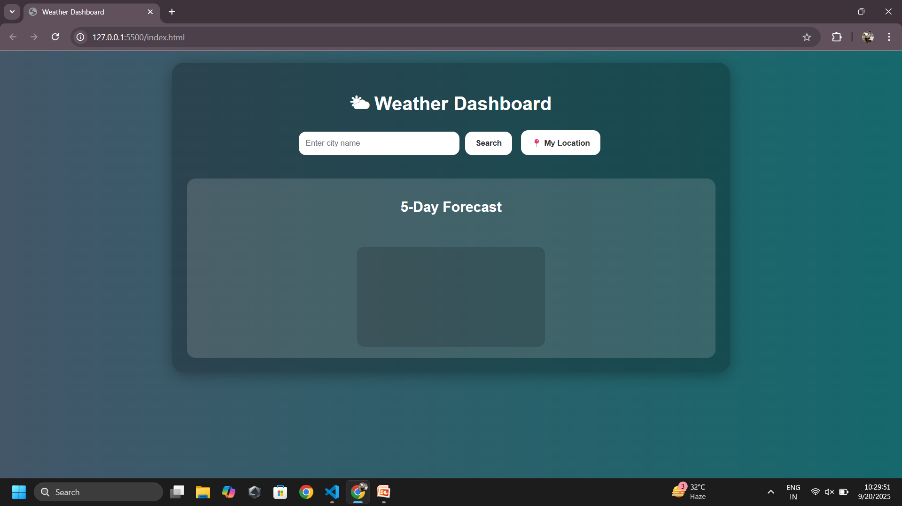
Result

Slide 7
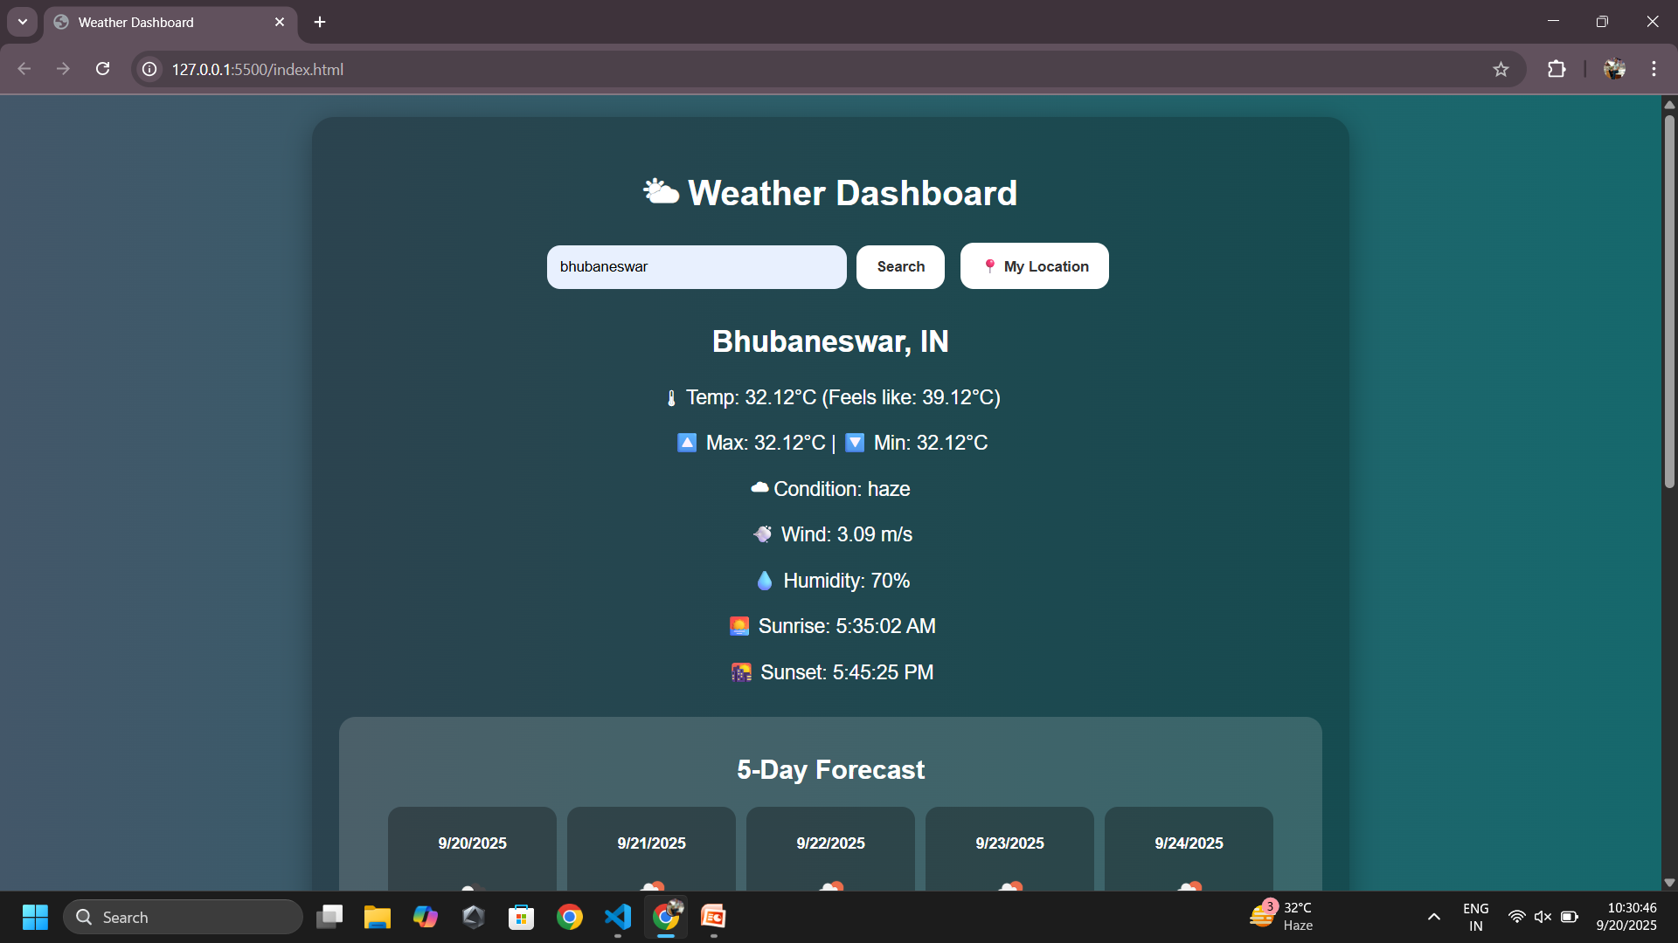
Temperature

Slide 8
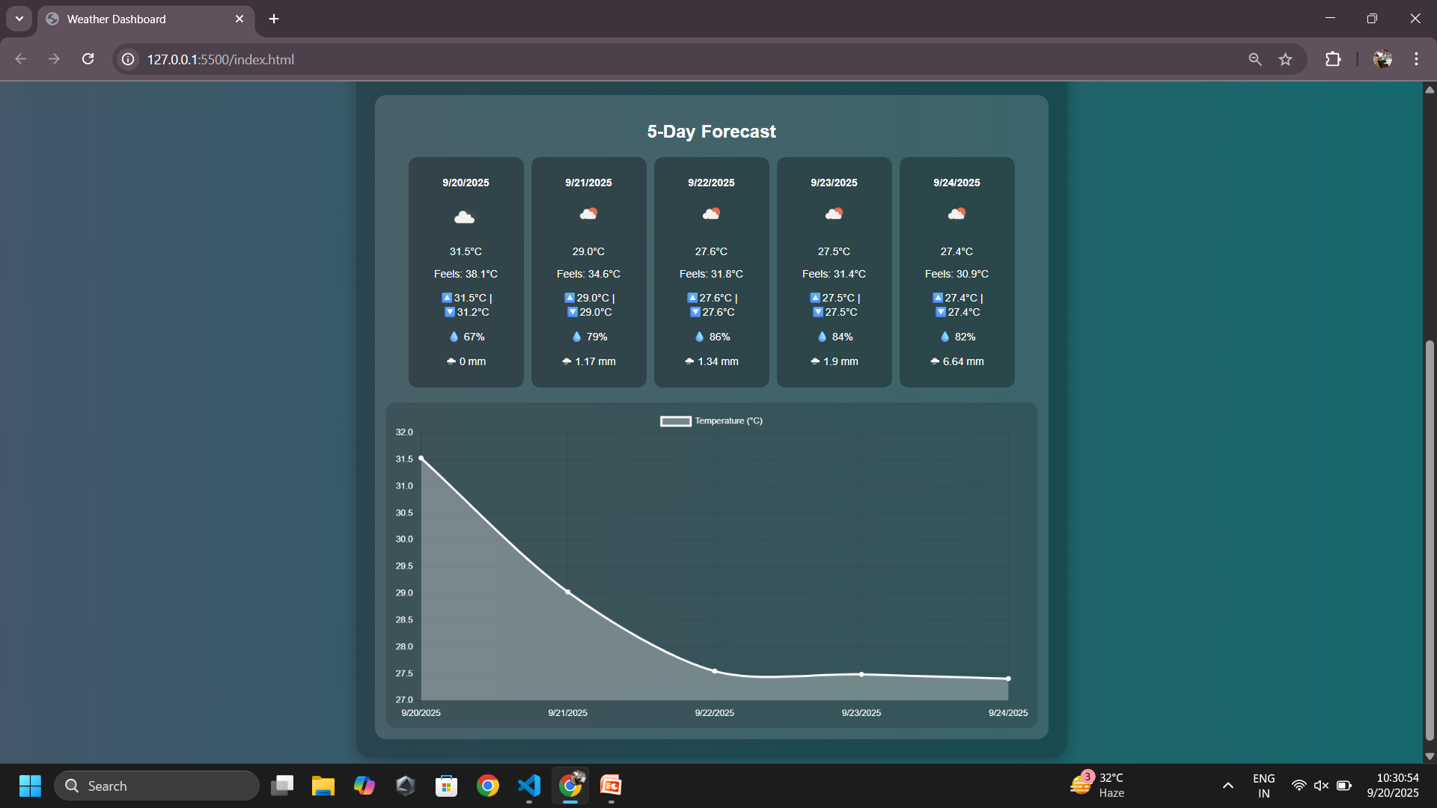
5 days forecast and chart

Slide 9
Github Push link
https://github.com/kumarakash15/weather-dashboard
Github Host link
https://kumarakash15.github.io/weather-dashboard/

Slide 10
Conclusion
Provides an easy-to-use, visually appealing weather application.
Eliminates the need for switching apps.
Interactive, responsive, and informative weather experience.

Slide 11
Future scope(Optional)
Backend Integration (Node.js/Express) – to manage user accounts and allow saving favorite cities.
Push Notifications – real-time alerts for severe weather conditions.
Hourly Forecast Support – provide more detailed weather predictions.
Dark/Light Theme Toggle – enhance user experience with customizable themes.
Mobile App Version – extend the dashboard as an Android/iOS app.

Slide 12
References
OpenWeatherMap API
Chart.js Documentation
MDN Web Docs (JavaScript, Fetch API, CSS)

Slide 13
THANK YOU

